Slide 1
Food Map Redesign

Slide 2
01
Production process of an apricot jam
02
Jam food system map
03
How can we increase sustainability in a processed food?

Slide 3
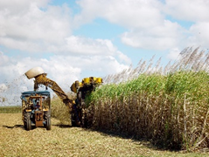
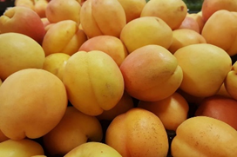
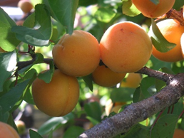
Production process of an apricot jam
Sugar cane
Sugar production factory
Transporting sugar to jam making factory
Transporting
Source (photo): Free Images
Grading/sorting
√
X
Apricots mixed with sugar (and any other ingredients)
Picking apricots at the apricot tree field
Cutting / seed removal
Transporting
washing
Source (photo): Pixabay
Source (photo): Free Images
Selling points (e.g. supermarkets, restaurants, etc.)
Transporting
Packaging the jam
Heating

Slide 4

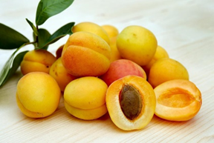
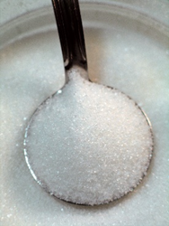


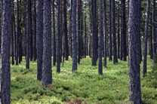
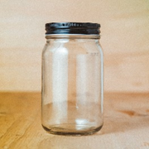

Jam food system map
Source (photo): Pixabay
Source (photo): Free Images
Source (photo): Free Images
Source (photo): Free Images
Labels
Source (photo): Pixabay
Source (photo): Unsplash
Sand
Source (photo): Free Images
Source (photo): Unsplash
Source (photo): Pixabay

Slide 5
How can we increase sustainability in a processed food?
Some ways are:
Go for local ingredients - decrease transportation (by land, air and water)
Go for seasonal ingredients
Go for organic ingredients

Slide 6


Q&A
Follow us on

Slide 7
Thank you!

